Slide 1

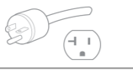

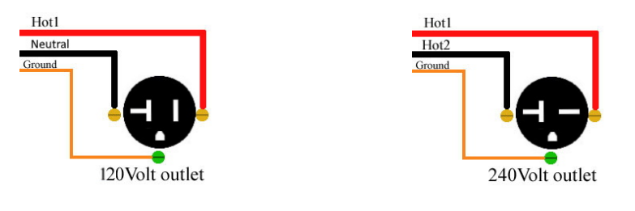
Electrical requirements sun & soul
UNIT | ELECTRICAL DESCRIPTION | COMMENTS
 | Electrical Requirement 120V / 1,680W / 14AMP NEMA 5-15 Plug | NEMA 5-20P https://shop.worldcordsets.com/shop/reference-materials/nema-reference-guide#6p
 | Electrical Requirement 120V / 1,820W / 15.17AMP NEMA 5-20 Plug | NEMA 5-20P Plug https://shop.worldcordsets.com/shop/reference-materials/nema-reference-guide#6p
 | Electrical Requirement 120V / 2,180W / 18.17AMP NEMA 5-20 Plug | NEMA 5-20P Plug https://shop.worldcordsets.com/shop/reference-materials/nema-reference-guide#6p
240V units require a 2-Pole Breaker --- All units are Single Phase
Sun-1i
Sun-2i
Sun-3i

